Slide 1
Student Help Buddy

Slide 2
Who are we?
Ewaoluwa Ajani, Maksym Batrak, Ewa Bender and Jack Donaghy

Slide 3


Slide 4


Slide 5
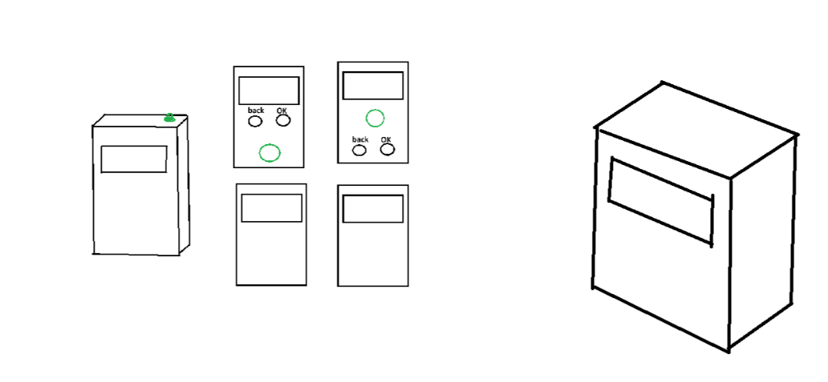
Features
Student timer, - interaction, screen, buzzer.
Check list, - interaction, screen.
Student toggle – led, interaction, screen, on/off switch.
Other – on/off switch.

Slide 6

Q&A

